Slide 1
Fan-out, Fan-in Pattern
Ehtisham khan FA20-BSE-039
Abbas Masood FA20-BSE-001
Video Link: https://www.youtube.com/watch?v=v5pm9frC6ck

Slide 2
Introduction
Fan-in, Fan-out is a programming pattern.
It's all about collaboration and coordination.
Like a synchronized tasks work together efficiently.

Slide 3
What is Fan-out?
Fan-out is the initial phase.
Imagine friends splitting tasks.
Each friend handles a specific job concurrently.

Slide 4
What is Fan-in?
Fan-in is the collaborative phase.
Friends come together, sharing their results.
Combining efforts for a shared goal.

Slide 5
Benefits of Fan-in, Fan-out
Tasks done in parallel for faster execution.
Optimal use of available resources.
Team members work together seamlessly.

Slide 6
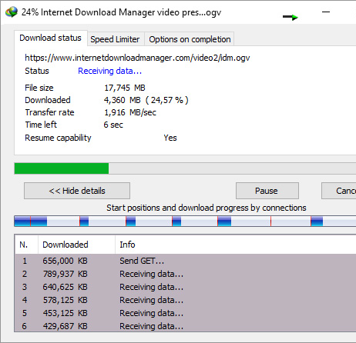
Example

Slide 7
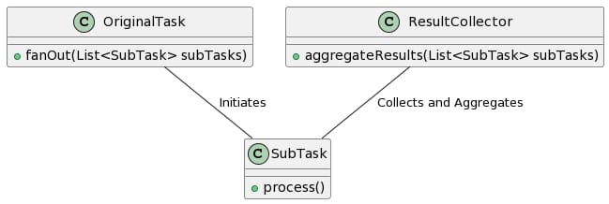
Class Diagram

Slide 8
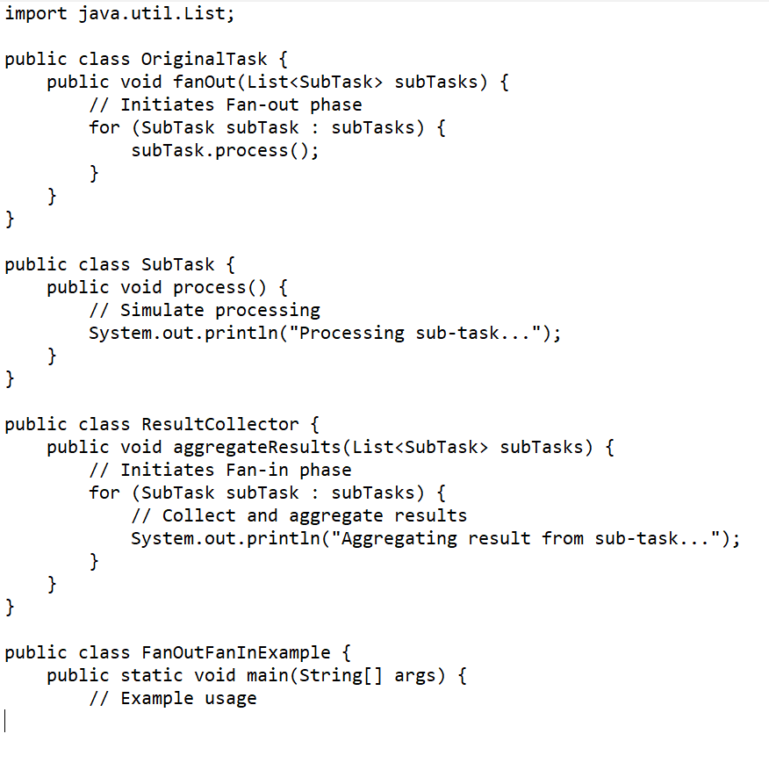
Code

